Slide 1
Training documents
OCP – “Transport & Shipping notification”

Slide 2
Intro: General information
Pickup order (= announcing of a pickup)
Supplier places pickup order in advance in BSH Supplier Portal which will be transmitted automatically to BSH and forwarder Terms of delivery / Incoterm is „EXW“ or „FCA“
Part-load traffic (LTL, LCL), Full Truck / Container Load (FTL, FCL)
Forwarder will be commissioned automatically by BSH
The day before pickup the forwarder receives all relevant information for the pickup (time slot, range of loading, weight, volume, number of pitches, specifications,…)
There is no airfreight / empties via Supplier Portal, but truck and sea freight
Shipping notification (= more detailed information regarding material)
Supplier places information for the shipped material (delivered quantity, delivery/invoice number)
no need of shipping notifications for the factory in Greece 5301 FCGA and Service Parts

Slide 3
Chapters
1
-
5
--> General information & Support
1
-
7
--> Create Pickup Order
1
-
5
--> Create Shipping Notification
1
-
12
--> Editing and Deleting of a loading
1
-
3
--> Overview & Download functionality

Slide 4
1
Dimenstions of Packaging Material
1 = Abbreviation; 2 = Dimensions; 3 = Volume in cbm; 4 = Meaning
1
EWPal – 1WPA
1
EUpal - Eupa
1
GiBo - Grid
2
120 x 80 centimetre
2
120 x 80 centimetre
2
124 x 97 x 83,5 centimetre
3
120 x 80 x Height (in centimetre)
3
120 x 80 x Height (in centimetre)
3
1,01 cbm
- Disposable pallet
- Won´t be changed by carrier
- Standard euro pallet
- Will be changed by carrier (back to the supplier)
4
4
4
- Standard grid box
- Will be changed by carrier
1
Other
1
OVER- Oversized
1
Number of pitches
2
2
Larger than 125 x 85 centimetre
2
120 x 80 centimetre respectively 0,4 loading meter
3
Length x Width x Height (in centimetre)
A pitch is the area, which an EUPal with standard dimension 120 x 80 centimetre (0,96m³) occupies
Stackability has to be considered when entering number of pitches
Entry without comma
3
Special load carriers or other packaging
Won´t be changed by carrier
At least one dimension is larger than standard
Won´t be changed by carrier
4
4
4

Slide 5
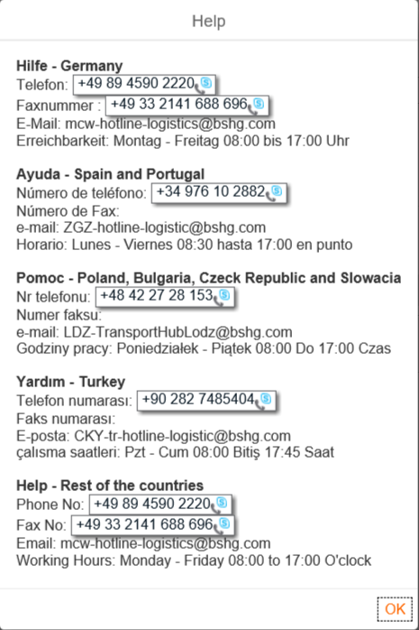
2
Support
Support
Loading cannot be entered
not possible to select the factory
Goods supplier is missing
scheduling agreement is missing
not possible to save the notification
No access to portal
please us the attached excel formula for informing about the failure precisely
e.g.:
Notes:
Wenn TR-Tel neu, neuer screenshot

Slide 6
3
Overview of BSH factories
division | country | location | factory number | factory abbr.
Consumer Products | China | Nanjing | 5531 | FCPNa
 | Germany | Bad Neustadt | 5071 | FCPB
 | Spain | Vitoria | 5251 | FCPV
 | Poland | Rogoznica | 5345 | FCPR
Cooking | China | Nanjing | 5532 | FCGN
 | France | Lipsheim | 5101 | FCGL
 | Germany | Traunreut | 5051 | FCGT
 |  | Bretten | 5061 | FCGB
 | Greece | Athens | 5301 | FCGA
 | Poland | Wroclaw | 5346 | FCGWr
 | Spain | Santander | 5221 | FCGS
 |  | Montanana | 5242 | FCGM
 | Turkey | Cerkezköy | 5323 | FCGI
 | USA | New Bern | 5602 | FCGNb1
 |  | New Bern | 5603 | FCGNb2
 |  | La Follette | 5621 | FCGF
Dish Care | Germany | Dillingen | 5031 | FDCD
 | Poland | Lodz | 5342 | FDCL
 | Spain | Estella | 5201 | FDCE
 |  | Montanana | 5241 | FDCM
 | Turkey | Cerkezköy | 5324 | FDCI
 | USA | New Bern | 5601 | FDCNb
 | China | Chuzhou | 5513 | FDCCh
Electronics Systems | China | Nanjing | 5533 | FEDNa
division | country | location | factory number | factory abbr.
Laundry Care | India | Chennai | 5720 | FLCCn
 | China | Nanjing | 5534 | FLCNa
 |  | Wuxi | 5501 | FLCW
 | Germany | Nauen | 5022 | FLCN
 | Poland | Lodz | 5341 | FLCL
 |  | Lodz-Dabrowa | 5343 | FLCD
 | Russia | St. Petersburg | 5372 | FLCPb
 | Spain | La Cartuja | 5231 | FLCC
 | Turkey | Cerkezköy | 5322 | FLCI
Refrigeration | China | Chuzhou | 5511 | FRFC1
 | Germany | Giengen | 5041 | FRFG
 | Poland | Wroclaw | 5347 | FRFWr
 | Russia | St. Petersburg | 5371 | FRFPb
 | Spain | Esquiroz | 5211 | FRFE
 | Turkey | Cerkezköy1 | 5321 | FRFI1
 | Turkey | Cerkezköy2 | 5321 | FRFI2
Service Parts | USA | New Bern | 6452

Slide 7
4
Placing Pickup Notification
When to place Pickup notification:
The latest 4 working days prior Pickup:
LTL and FTL ex Italy to Europe
-6 WD -5 WD -4 WD -3 WD -2 WD -1 WD Pickup day
The latest 6 working days prior Pickup:
FTL and FCL to Overseas, Russia and Turkey
The latest 1 working day prior Pickup (before 14 o´clock):
LTL / LCL as well as FTL / FCL, if supplier and receiving factory are located in the same country

Slide 8
5
!
More advises for Export
!
entries for the pickup order (weight, volume, load carriers) have to match with the entries on the delivery note, bill of loading and export documents
pickup order should only be created when all shipment- and customs-documents are complete and available
a) To Russia / to Turkey
In addition to the creation of the pickup order and the shipping notification via the supplier portal:
The shipping and customs documents have to be sent beforehand via mail or fax to your contact person at the receiving factory and if necessary to the regional carrier. This has to be made for the creation of export documents and for verification of the documentation:
Suppliers with a pickup location in Germany with a zip code of 01-59 as well as 99 report these documents:
For Turkey to carrier Rieck: bsh-belog@rieck-logistik.de
For Russia to Hub Nauen: NAU-INBOUND@bshg.com
Suppliers with a pickup location in Germany with a zip code of 60-98 report these documents:
For Turkey to carrier Döderlein: bshg@romanmayer-group.com
For Russia to Hub Nauen: NAU-INBOUND@bshg.com
b) to USA / China / India
In addition to placing transport and shipping notification in supplier portal, the shipping and export documents have to be send to: - Nauen for USA: NAU-INBOUND-USA@bshg.com
- Nauen for China: NAU-INBOUNd-CHINA@bshg.com
- Nauen for India: NAU-INBOUND-INDIEN@bshg.com
c) to India
The original documents have to be sent via CEP (Currier Express Parcel) to BSH-Hub Nauen (NAU-INBOUND-INDIEN@bshg.com)

Slide 9
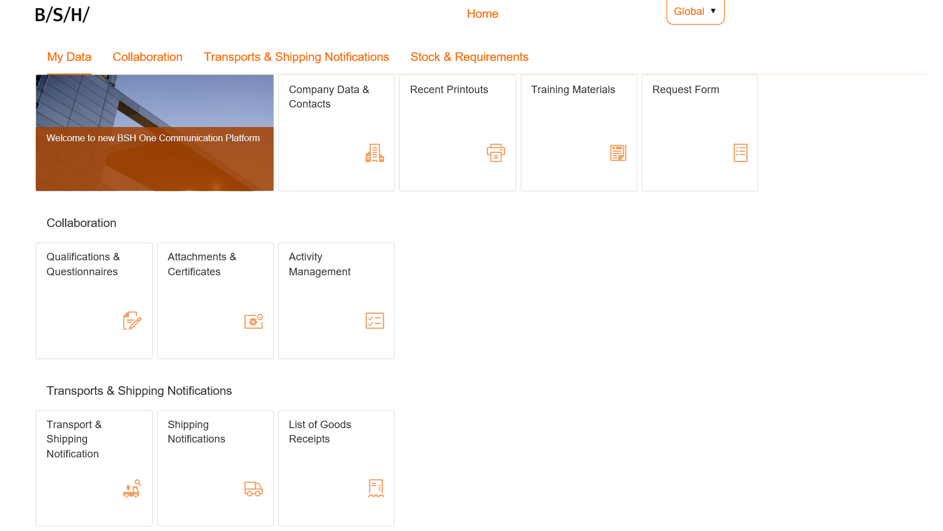
1
Start screen for selecting the app „Transport & Shipping notification“
Click on Transport & Shipping Notification for Pickup orders

Slide 10
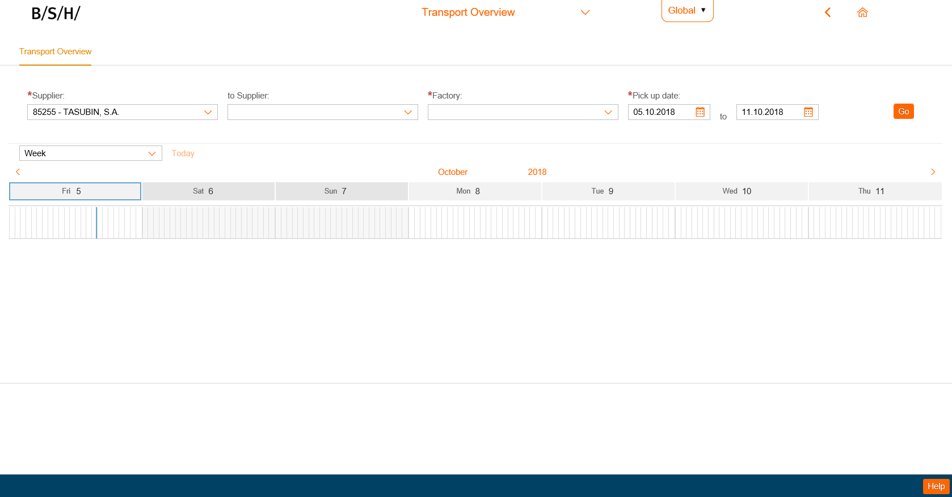
2
Fill all red lined boxes, click on „Go“ – all placed loadings within the selected time range will be shown
123 - Dummy
1
2
3
4
5
Time period is prefilled with the following week; it can manually be changed anytime.
Notes:
anpassen, dass Lieferant und Zeitraum vorausgefüllt ist, Zeitraum angepasst werden kann (REMINDR für Testen: kommt Meldung “no data selected”, wenn vorausgefüllt)

Slide 11
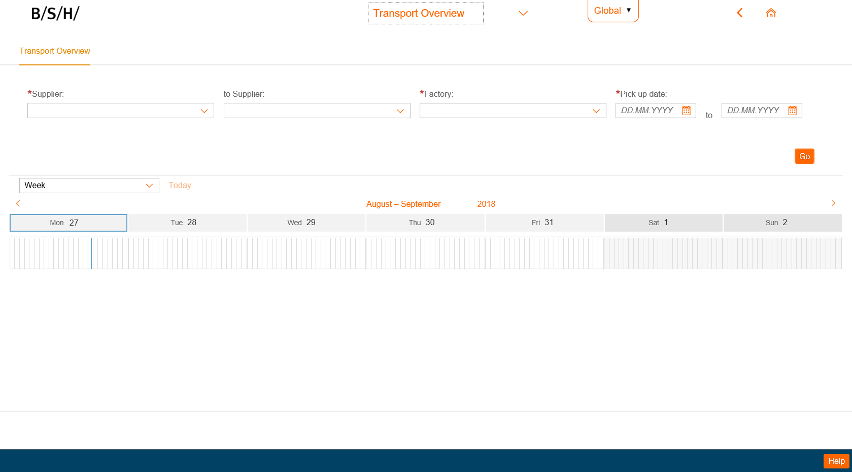
3
For support, click „Help“. Choose your related contact.
Notes:
Merken: neuer screenshot mit upgedateter TR-Nummer nötig

Slide 12
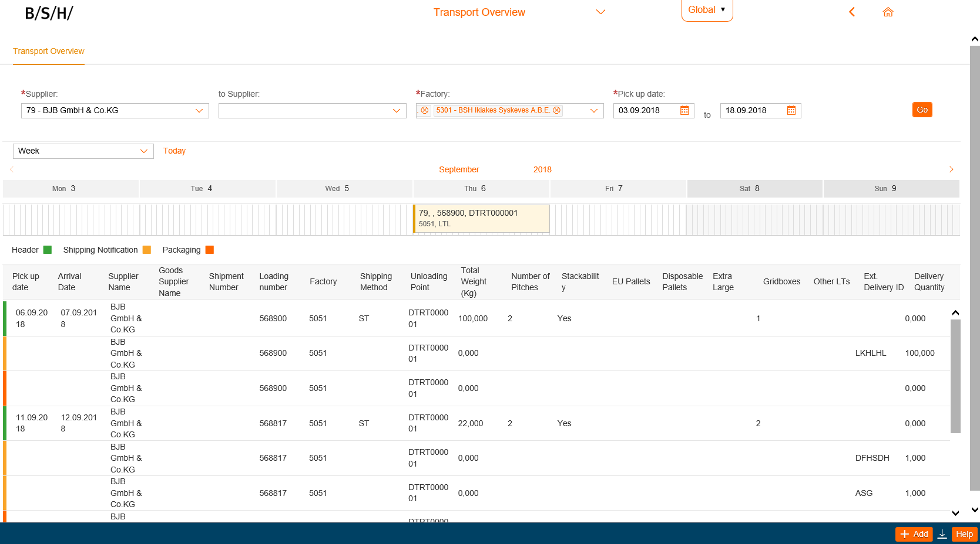
4
For entering a new Pickup notification, click on „add“
123 - Dummy

Slide 13
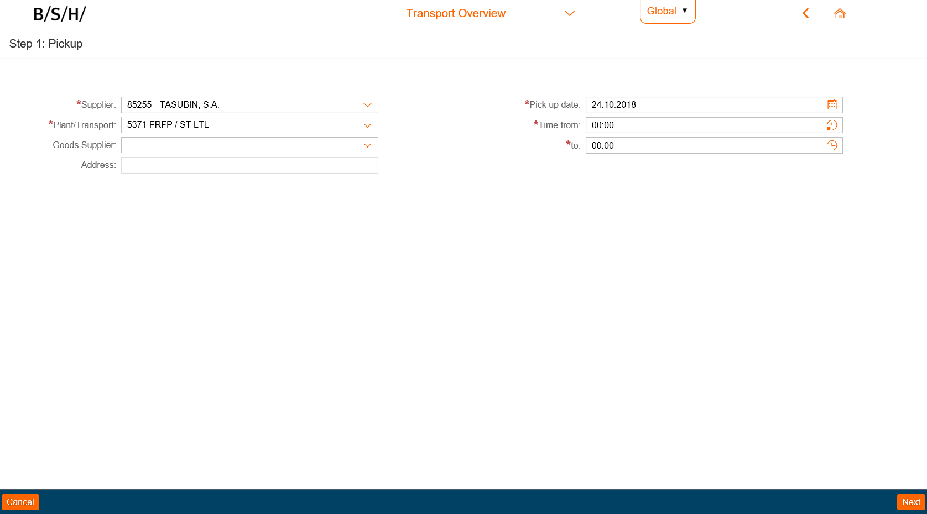
5
Enter details for the pickup in related fields and click „Next“.
123 - Dummy

Slide 14
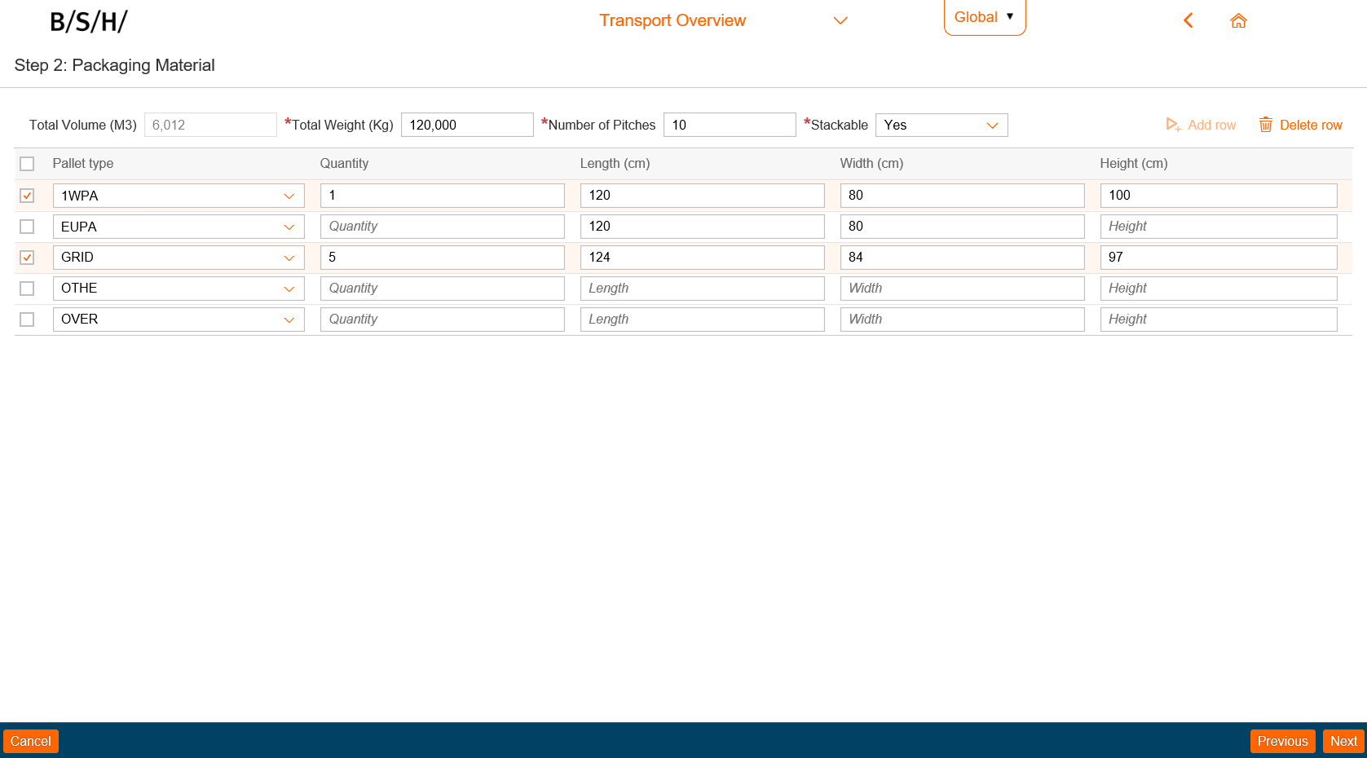
6
Enter dimensions of packaging material (pallet type, stackable?, quantity, dimensions). Click „Next“ to proceed
When having different dimensions for one pallet type, you can change the pallet type to the needed one.
Adding a new row is possible when all five prefilled pallet types are filled.
For deleting a row, it´s box has to be checked.

Slide 15
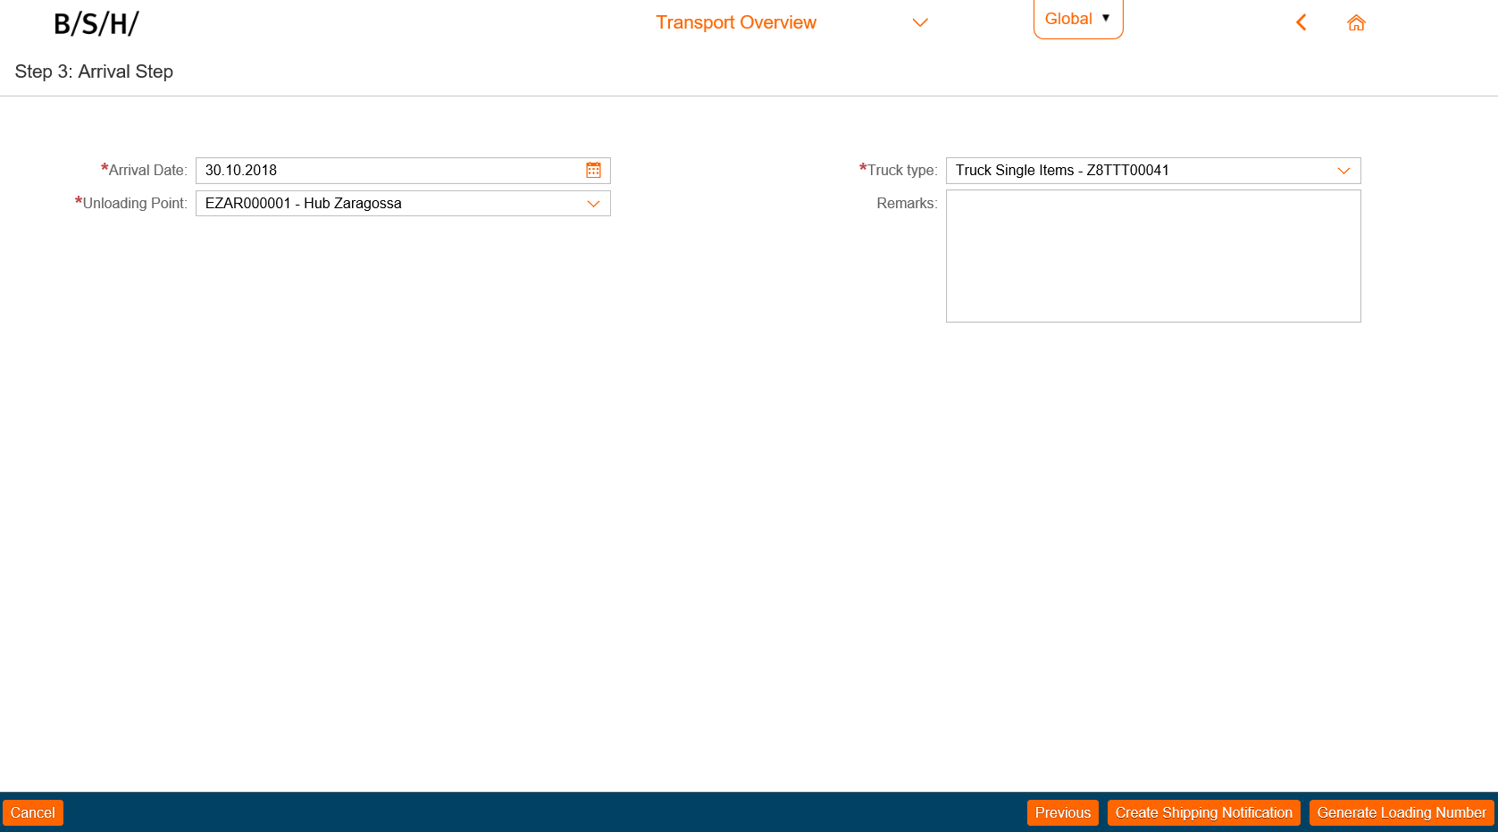
7
Enter Information for this loading.
Click either „Create Shipping Notification“ or „Generate Loading Number“
Not relevant for factory 5301, 6452, 6331, 1451 EDI and Mix/BISS
Shipping documents available?
Shipping documents not yet available?
Placing shipping notification is possible till the day of pickup.
1
1

Slide 16
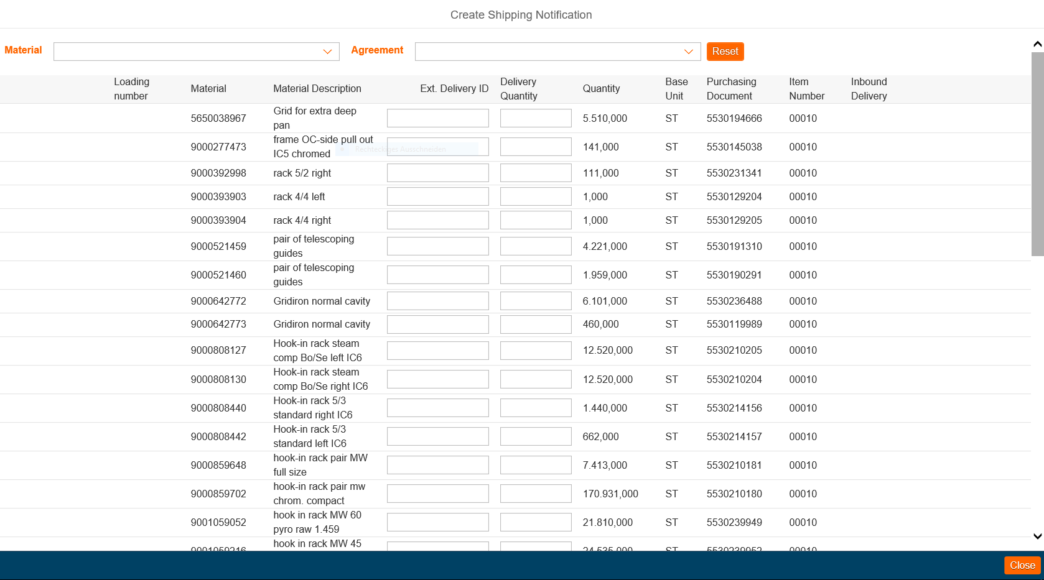
1
Enter your ext. Delivery ID and delivery quantity. If needed you can select by material and/or agreement.

Slide 17
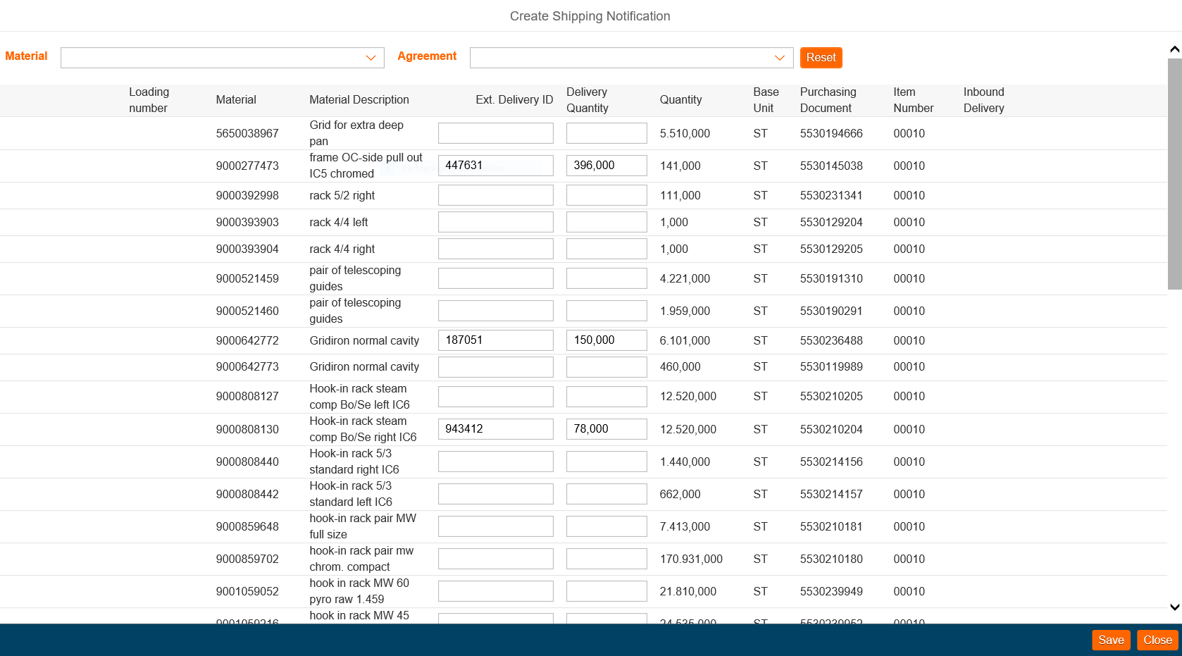
2
Click „Save“
Might be, you have to click with your mouse somewhere on the screen so that „save“ appears.

Slide 18
3
Customs handling for transports to Turkey
For shipments to Turkey “invoicing number”

Slide 19
4
Press „Generate Loading Number“

Slide 20
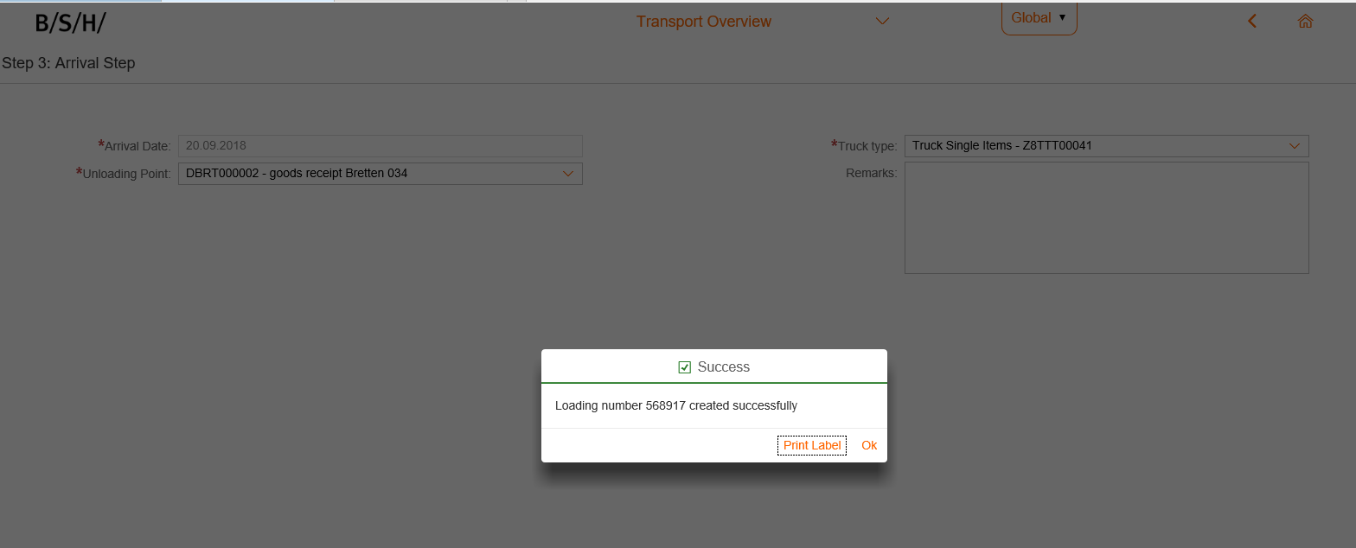
5
Loading is saved by pressing „OK“ or „Print Label“.

Slide 21
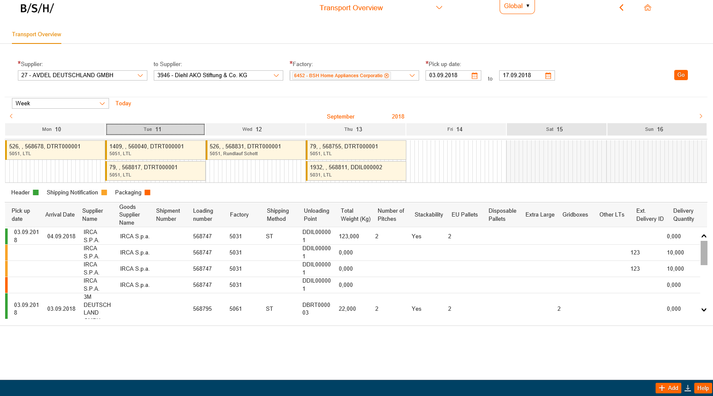
1
Start screen for editing and deleting of loadings.

Slide 22
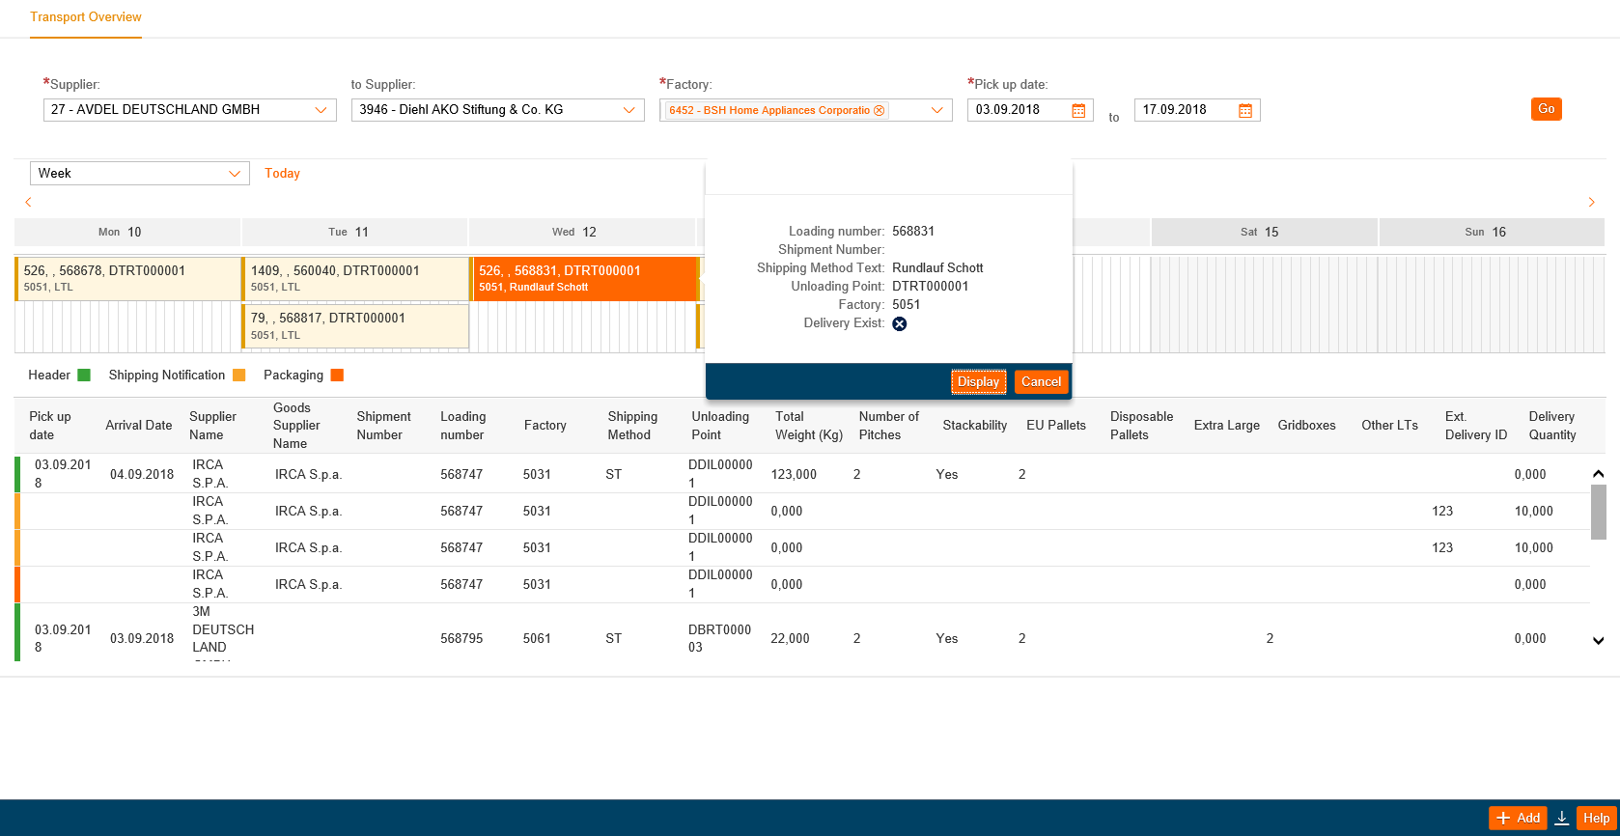
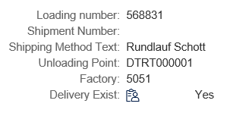
2
Select the loading
1
2

Slide 23
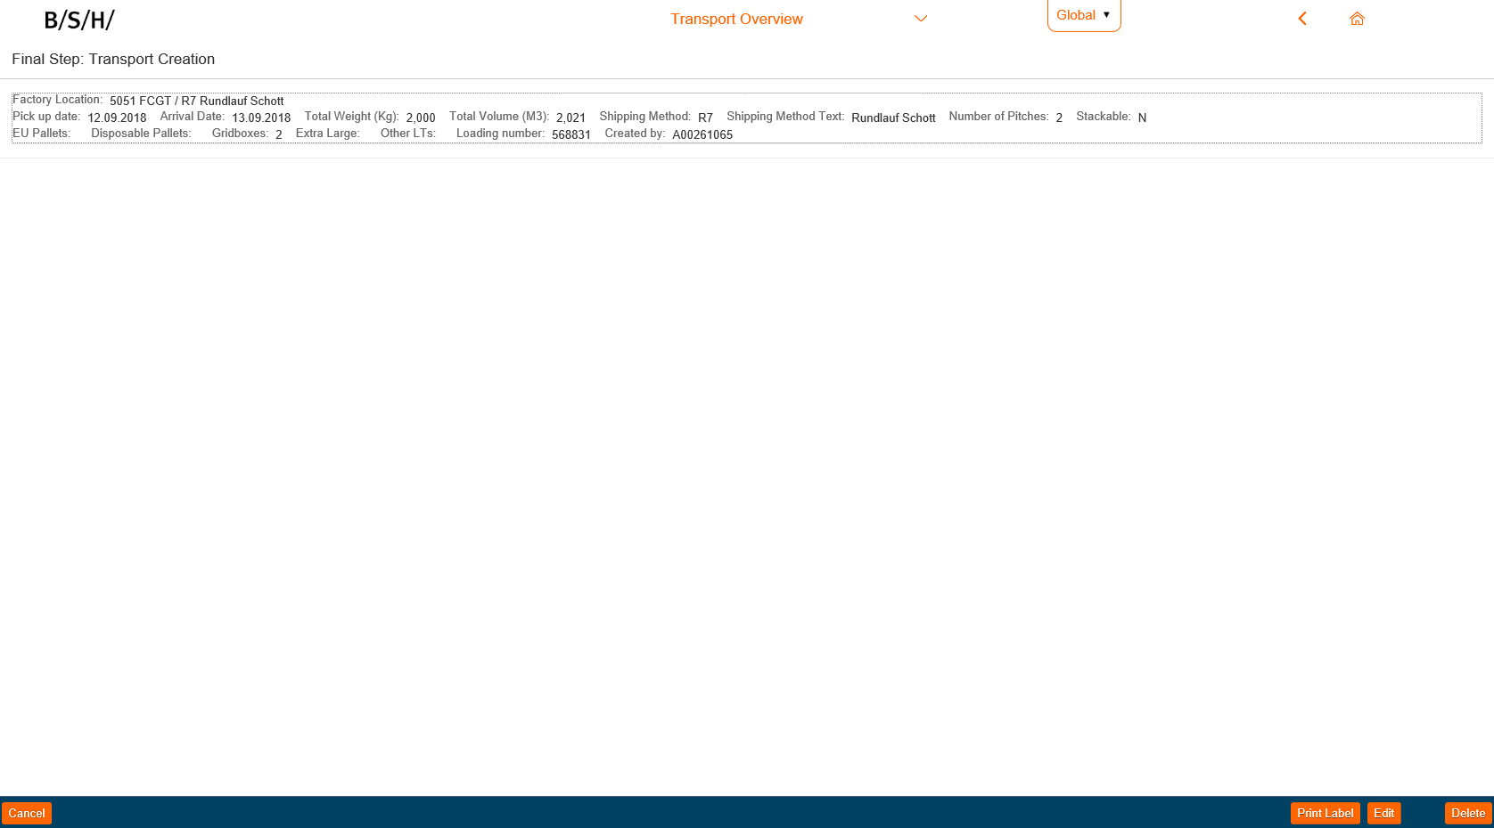
3
(1) Edit loading; (2) Delete loading
Important information for that loading → detailed overview
2.1
Please consider:
A cancellation 1 day before pickup day after 12:00 a.m. must be reported to the hotline, because carriers have already been notified
1
2

Slide 24
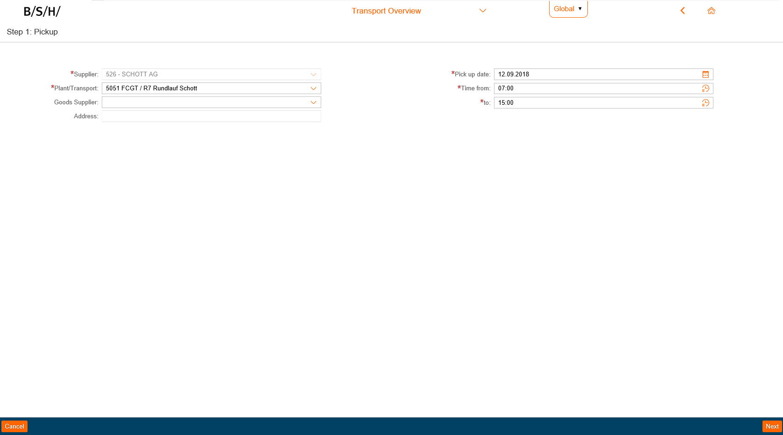
4
Grey marked fields cannot be changed anymore.
Pickup date can be changed till specific time

Slide 25
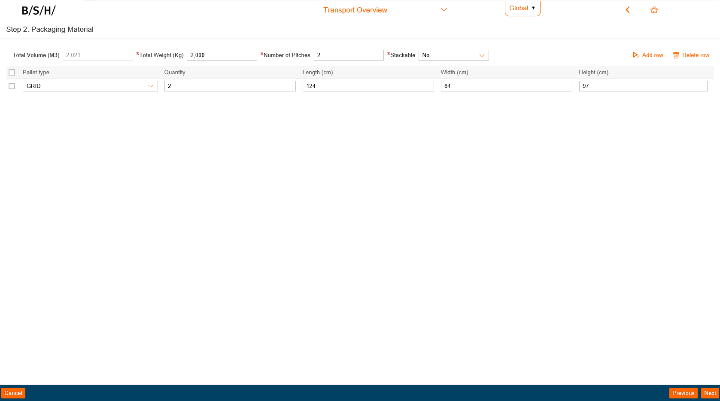
5
Packaging material can be changed and new pallet types can be added

Slide 26
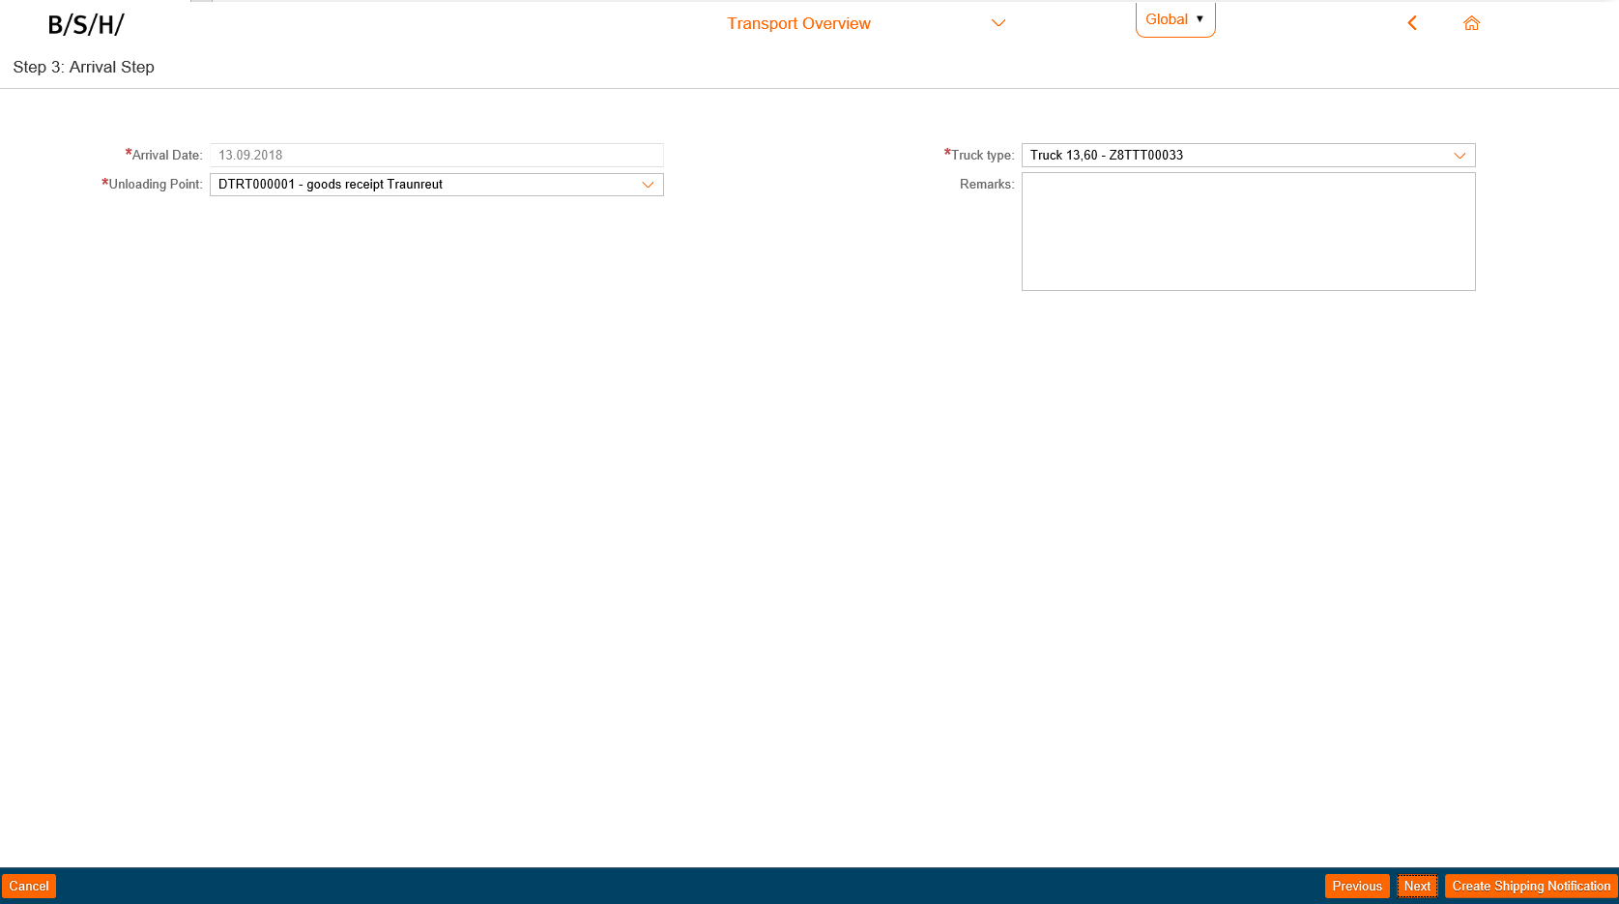
6
Grey marked fields cannot be changed anymore. Shipping notification can be created and added.

Slide 27
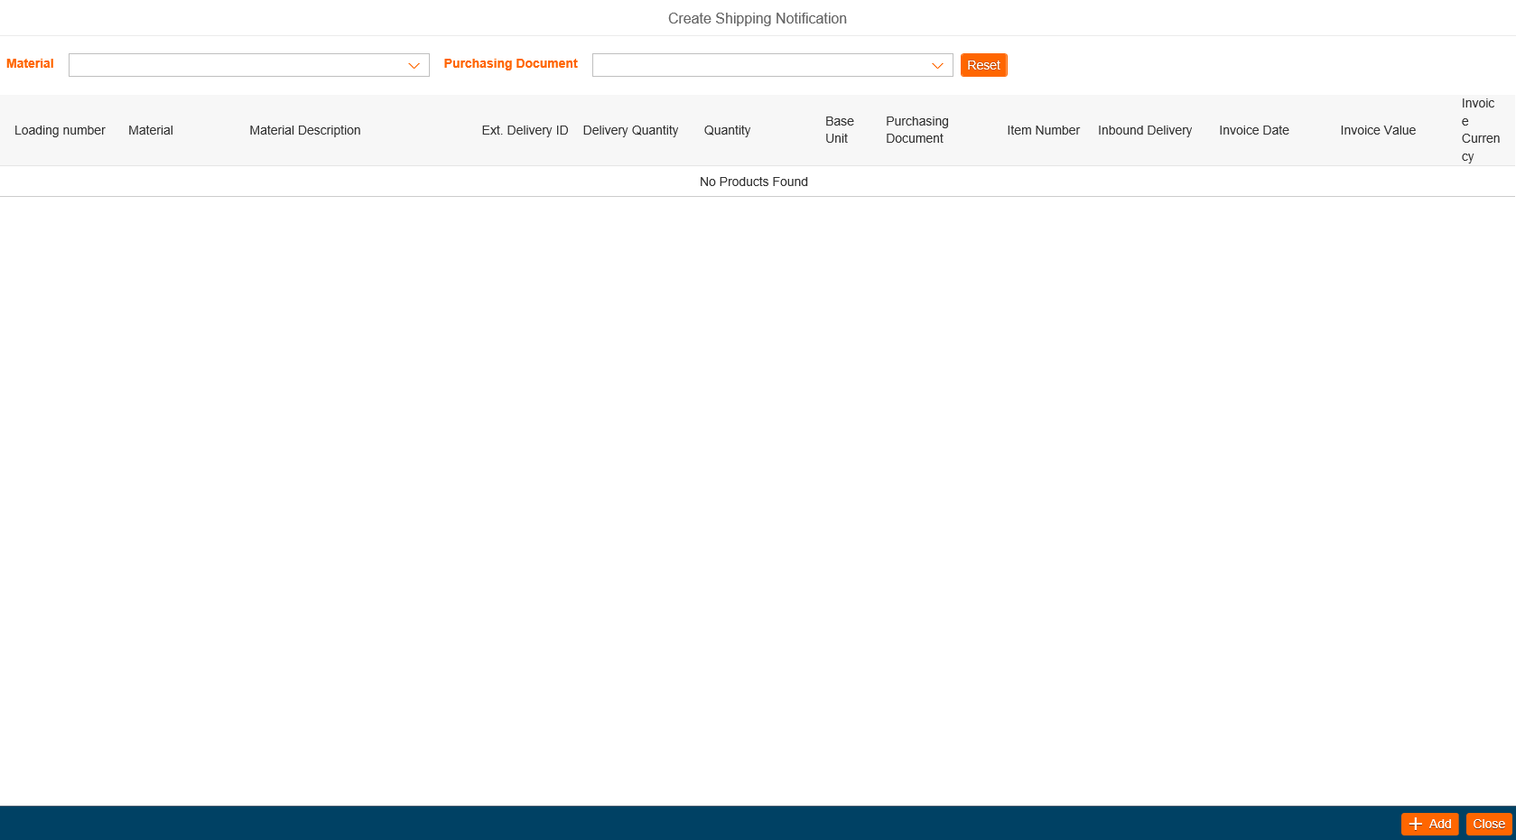
7
When entering a shipping notification, you have to press „Add“ so that material appears.

Slide 28
8
Enter your ext. Delivery ID and delivery quantity. If needed you can select by material and/or agreement.

Slide 29
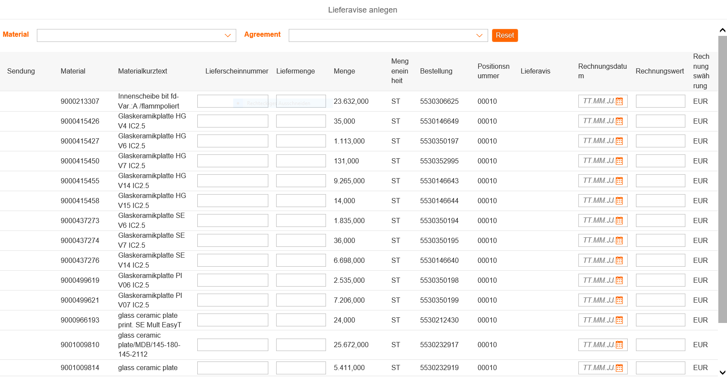
9
Customs handling for transports to Turkey

Slide 30
10
Click „Save“
Might be, you have to click with your mouse somewhere on the screen so that „save“ appears.

Slide 31
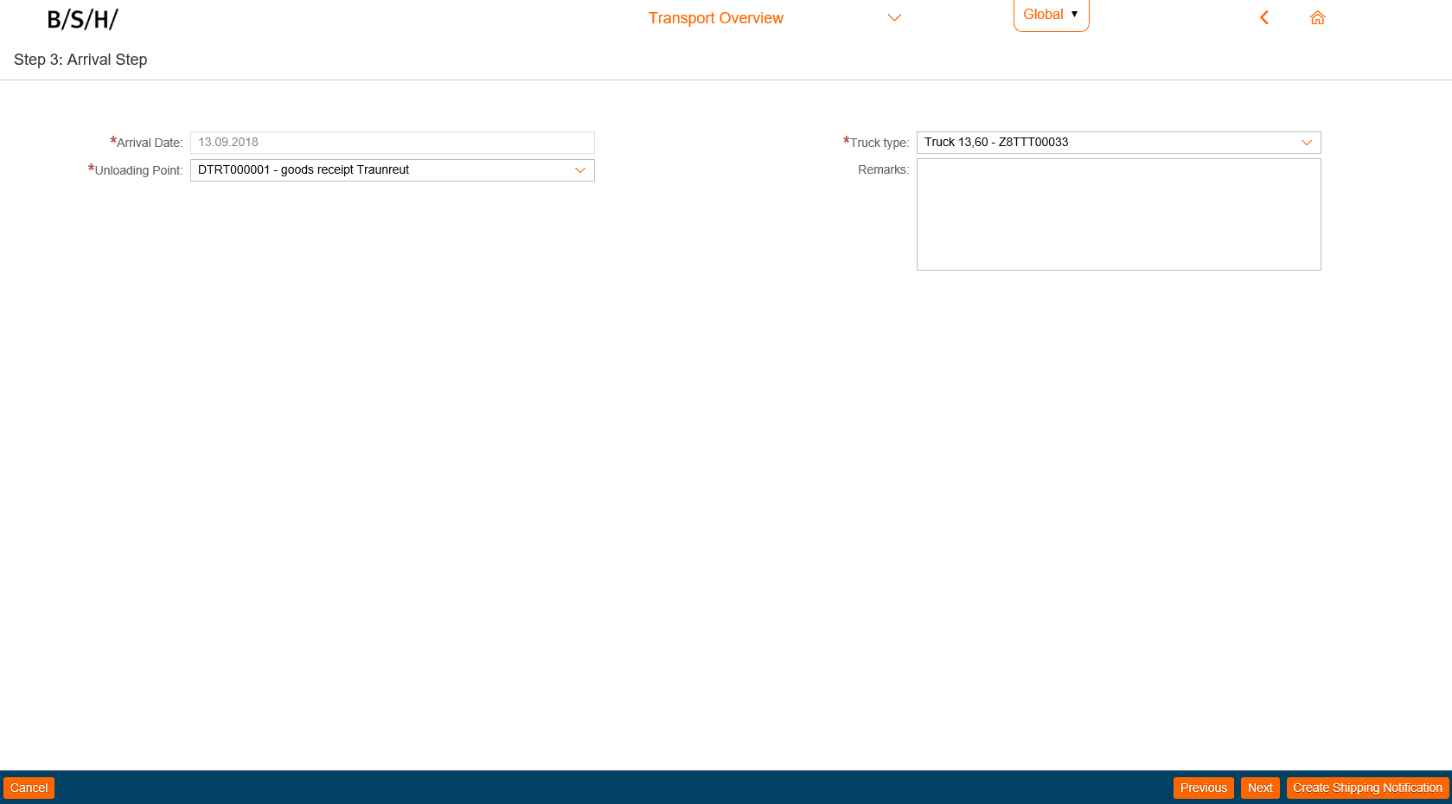
11
Click „Next“

Slide 32
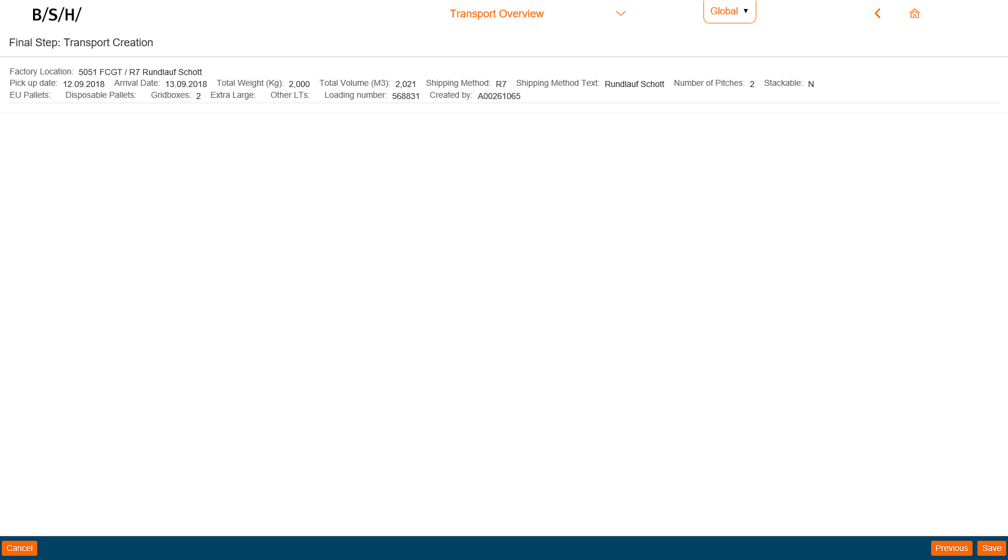
12
For finalising and saving, click „Ok“
2
1

Slide 33
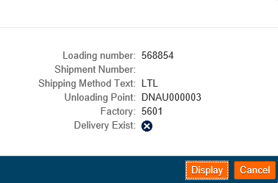
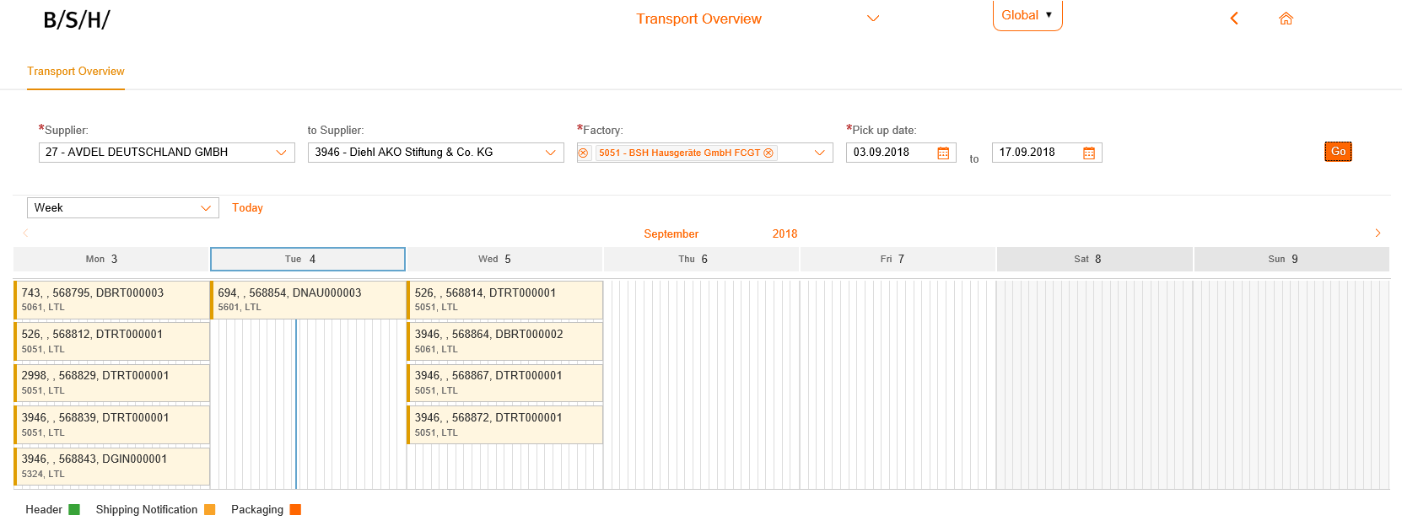
1
When clicking on a loading, detailed view appears
= NO
= YES
Notes:
Reminder: ggf. Kommt ja/nein neben Icon

Slide 34
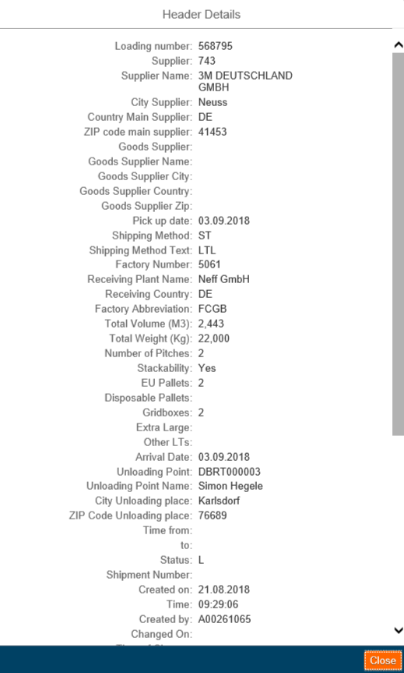
2
When clicking on „Header“, „Shipping Notification“ or „Packaging“
detailed overview appears

Slide 35
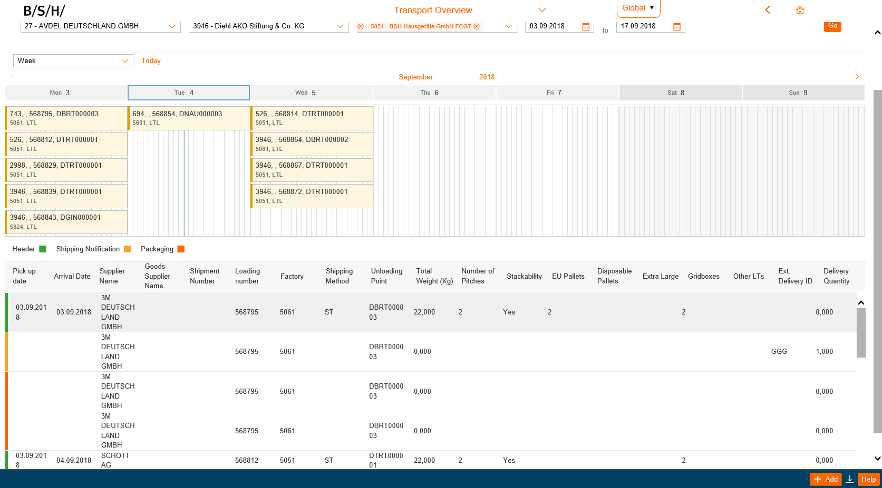
3
By clicking on the „Download symbol“ the report can be saved as an Excel document

